Slide 1

Global Animal Health Initiative: The way forward
Washington, 9 October 2007
OIE economic studies
part I:
Prevention versus outbreak costs
(by Agra CEAS Consulting)

Slide 2
Methodology
Scope / definitions
Results
Conclusions & recommendations

Slide 3
Main methodological tools:
Desk research: identification of relevant literature/data;
Literature review: analysis of available literature/data;
Consultations with key relevant institutions/authorities and experts;
Case studies in 4 countries: Argentina, Vietnam, Nigeria and Romania;
Development of an analytical model to provide detailed estimates of the costs of outbreaks (e.g. HPAI);
Analysis and synthesis of costs and benefits: comparison of prevention versus outbreaks costs.

Slide 4
Scope of the analysis:
Disease focus: Transboundary Animal Diseases (TADs), particularly of high zoonotic potential and/or socio-economic impact (e.g. HPAI, FMD);
Countries: all developing and transition countries which are members of the OIE;
Farming systems: wide differences in level of development have implications for bio-security, e.g. in poultry farming FAO typology distinguishes between four ‘sectors’ (sector 1: highly integrated/ large scale ... sector 4: ‘back-yard’ farming).

Slide 5
Veterinary Services (VS)
VS are at the very core of the prevention, control and eradication of animal diseases;
Their ability to effectively safeguard the livestock sector from such diseases is crucial for the protection both of public health and of rural livelihoods (in terms of food security and poverty alleviation);
These objectives are commonly classified in literature as ‘public goods’;
The provision of VS could be defined as an intermediate public good, the final public good being to guarantee the above objectives.

Slide 6
Definition: prevention costs
For the purposes of our analysis:
Prevention and control costs are defined as those incurred by governments during ‘normal’ times, i.e. in advance of outbreaks;
These include:
  Veterinary System: surveillance (including diagnostic capacity/laboratories); veterinary border inspection / customs; human resources; training and simulation exercises;
  Preventive vaccination: vaccine stocks / storage (cold chain); human resources;
  Bio-security measures: to the extent there is public intervention (e.g. animal identification, guidelines on animal movement etc.).

Slide 7
Definition: outbreak costs
For the purposes of our analysis we differentiate between:
Direct impact. Includes: direct losses (loss from the value of culled/lost animals, culling and disposal costs); control costs during and after the outbreak (e.g. equipment, facilities, (ring) vaccination where appropriate, etc.); consequential on-farm losses (due to fall in stock, movement restrictions etc.);
Indirect impact. Includes: ripple effects (on product prices and on upstream/downstream activities along the livestock value chain); spill-over effects: tourism and services are two sectors most severely affected; wider society: other economic losses due inter alia to effects on public health, particularly in case of a human pandemic.

Slide 8
Literature review: prevention costs /1
Assessment of costs at international level:
  review and analysis of financing framework under global/ regional programmes for the fight against diseases (e.g.: WB global financing needs and gaps for HPAI; FMD campaigns in SE Asia (SEAFMD), the Americas (PANAFTOSA); Pan-African programme for control of epizootics (PACE); etc.)
Assessment of costs at national level:
  review and analysis of national emergency and preparedness plans for AI and of WB projects under the GPAI (covered 47 countries in total);
  for Africa, ALIVE needs assessment for HPAI (covered 54 African countries in total)

Slide 9
Literature review: prevention costs /2
Key conclusions from our assessment:
Difficulties in comparing plans across countries;
This reflects the varying nature of needs and priorities in each country, including in terms of disease occurrence, farming structures, and existing veterinary systems and infrastructure;
Such specificities highlight the risks of extrapolating from ad hoc country cases to a regional and global level.

Slide 10
Literature review: prevention costs /3
Key conclusions from our assessment (cont’d):
To overcome these constraints, our analysis has been based on the global estimates provided by the World Bank, and on the Africa estimates by ALIVE;
The problems encountered during our analysis highlight the importance of a systematic assessment of every country’s needs, based on objective criteria;
In this context, the recently started country reviews (using the OIE PVS tool) provide a substantial first step in this direction.

Slide 11
Literature review: outbreak costs /1
Key conclusions:
The economic costs of major TADs are largely under-studied, particularly in developing/ transition countries (with the notable exception of some studies of CBPP, RVF and rinderpest in African countries);
In recent years, following major outbreaks (FMD, HPAI) and mounting concern worldwide on their potential repercussions, more examples of such analysis have started to emerge;
Existing literature is relatively scattered, concentrating on particular diseases, countries, and types of impact, within specific often short time periods. Few examples of systematic analysis at a regional level and across the broad spectrum of types of impact;

Slide 12
Literature review: outbreak costs /2
Key conclusions (cont’d):
Wide consensus that indirect or longer term impacts (such as loss of consumer confidence or the effects on trade and tourism) are far greater than the direct or shorter term impacts (loss of poultry value, consequential on-farm losses);
Beyond this broad observation, on a worldwide level there is a need to determine the extent and relative importance of the various impacts in more detail;

Slide 13
Literature review: outbreak costs /3
Key conclusions (cont’d):
Our analysis seeks to address this gap by estimating the various impacts for individual countries and on a world scale;
Determining the relative scale of the range of impacts, and therefore the potential benefits involved in addressing these, is essential for policy-making. Enables policy-makers to identify the potential benefits of improved prevention and control policies in order to define the relative cost-benefit of alternative options, so as to concentrate on appropriate and proportionate policy measures and investment decisions in each case (disease, country, region).

Slide 14
Literature review: comparison of prevention to outbreak costs /1
Key conclusions:
In relatively few cases the analysis on the benefits of improved animal disease prevention and control can be defined as a full classical CBA;
The majority of the reviewed studies consider the most measurable types of benefit, notably trade impacts;
Tendency to focus on: specific components of prevention and control systems, specific diseases, specific countries (or even regions within countries), specific epidemiological conditions in which prevention and control measures may be applied, specific types of costs and benefits and conditions under which the costs and benefits are generated;

Slide 15
Literature review: comparison of prevention to outbreak costs /2
Key conclusions (cont’d):
Results of this type of analysis depend heavily on the underlying scenarios/assumptions;
The implication is that a) they often need to be interpreted within the context in which they have been generated; and b) comparison and extrapolations from individual case studies are constrained and should be treated with caution;
Nonetheless, a common observation may be made: in all the cases reviewed here, existing studies conclude that the significant benefits that accrue from improved prevention and control measures outweigh the cost of investment.

Slide 16
Economic analysis of global outbreak costs /1
To estimate the potential global impact of an animal disease, we have developed a specific analytical tool;
This incorporates a baseline, scenarios and assumptions on key parameters from which to estimate the detailed direct and indirect costs of a disease outbreak;

Slide 17
Economic analysis of global outbreak costs /2
Our aim has been to develop a flexible tool, rather than solely provide estimates as such: the baseline, assumptions and scenarios can be improved/refined at any point in time, as further research and evidence on a disease impact becomes available;
The results aim to highlight the relative importance of the various direct and indirect impacts, so as to provide direction to policy-making in this field;
This tool has been specifically applied to the case of HPAI (see Annex 5 of Report), but it has the potential to be adapted for application in the case of other TADs.

Slide 18
Economic analysis of global outbreak costs (HPAI) /1
Key parameters:
Direct production costs and losses:
Direct losses | Number of poultry lost (died from the disease or culled) Average market value per head of poultry (pre-outbreak) Culling and disposal costs per head of poultry Control costs per head of poultry
Consequential on-farm losses | Farm income from activity per head of poultry Duration of farm business disruption
Indirect costs:
Ripple | Fall in domestic poultry prices Fall in domestic sales Fall in world poultry prices Fall in world poultry trade (exports) Duration of the above impacts
Spill-over | Loss in world tourism income value Duration of the above impact
Wider society | Loss in global GDP in the event of a human pandemic.

Slide 19
Economic analysis of global outbreak costs (HPAI) /2
Baseline:
Uses data derived from the combined analysis using literature review and the case studies;
The baseline on direct outbreak costs includes data from the case studies in Vietnam and Nigeria but also developments in other parts of the world and global developments as documented in the literature;
The baseline on indirect outbreak costs largely draws on the available evidence of world developments as presented in existing literature.

Slide 20
Economic analysis of global outbreak costs (HPAI) /3
Assumptions:
At a general level, the assumptions include duration of the impact (which depends on the duration and re-occurrence of the epidemic), the rate of disease spread and the coverage (in terms of countries);
At a cost-specific level, assumptions are made on the key parameters that define each type of cost. In the case of direct production costs and losses, these include the extent of poultry population loss, market value, culling/disposal costs, and control costs per head of poultry, and loss of income from business disruption (as indicated above).

Slide 21
Economic analysis of global outbreak costs (HPAI) /4
Scenarios:
A total of six scenarios were formulated, of which: three at country level and three at global level;
At a country level, the scenarios vary in terms of the duration of the impact of the epidemic and the intensity of disease spread within countries, as follows:
  Scenario 1 (“most likely”)
  Scenario 2 (“low impact”)
  Scenario 3 (“high impact”)

Slide 22
Economic analysis of global outbreak costs (HPAI) /5
Scenarios (cont’d):
At a global level, scenarios have been formulated on the basis of the geographical coverage of the disease worldwide, as follows:
  Scenario A includes only H5N1 infected countries;
  Scenario B includes the countries of scenario A and in addition infected and ‘non infected at immediate risk’ countries;
  Scenario C includes all developing/transition countries that are members of the OIE.

Slide 23
Economic analysis of global outbreak costs (HPAI) /6
Results - direct impact:
Cost estimates in the event of an HPAI outbreak are presented as a range between nine possible outcomes from a combination of the 6 scenarios outlined above (‘most likely’, ‘low impact’ and ‘high impact’ in terms of the disease impact, and A, B and C in terms of the geographical country coverage);

Slide 24
Economic analysis of global outbreak costs (HPAI) /7
Estimated global impact: direct costs and losses (in billion US$)
 | Impact: scenario 1 (most likely)
 | Poultry value losses | Culling/ Disposal costs | Control costs | Total impact (a)
Direct production costs/losses: Global impact, annual
Scenario A | 4.27 | 0.75 | 0.32 | 5.34
Scenario B | 4.90 | 0.86 | 0.37 | 6.12
Scenario C | 7.76 | 1.36 | 0.58 | 9.71
Direct production costs/losses: Global impact, total
Scenario A | 8.54 | 1.50 | 0.64 | 10.68
Scenario B | 9.80 | 1.71 | 0.73 | 12.25
Scenario C | 15.53 | 2.72 | 1.16 | 19.41
(a) Includes animal value losses, culling/disposal and control costs

Slide 25
Economic analysis of global outbreak costs (HPAI) /8
Estimated global impact: total direct costs
including consequential on-farm losses (in billion US$)
 | Impact: scenario 1 (most likely)
 | Direct production costs/losses, total impact (a) | Consequential on-farm losses | Total direct impact, including consequential on-farm losses
Global impact, annual
Scenario A | 5.34 | 6.41 | 11.75
Scenario B | 6.12 | 7.35 | 13.47
Scenario C | 9.71 | 11.64 | 21.35
Global impact, total
Scenario A | 10.68 | 12.81 | 23.49
Scenario B | 12.25 | 14.70 | 26.94
Scenario C | 19.41 | 23.29 | 42.70
(a) Includes animal value losses, culling/disposal and control costs

Slide 26
Economic analysis of global outbreak costs (HPAI) /9
Results - direct impact (cont’d):
These estimates allow us to draw some general conclusions on the structure of these costs notably on:
The importance of poultry value losses (80% of total direct production costs and losses);
The importance of consequential on-farm losses (55% of the total direct impact);

Slide 27
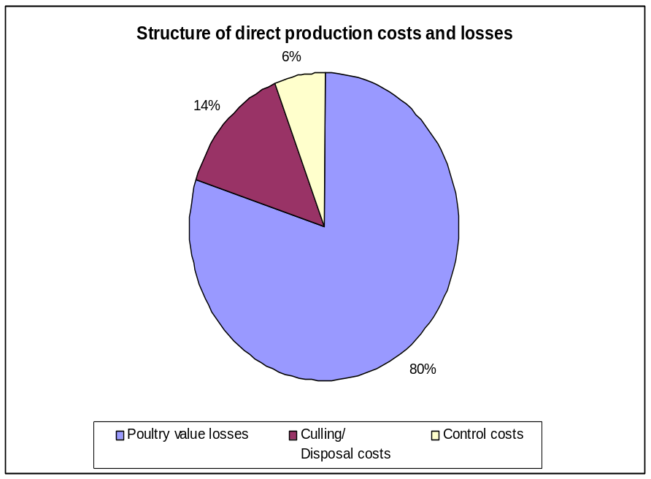
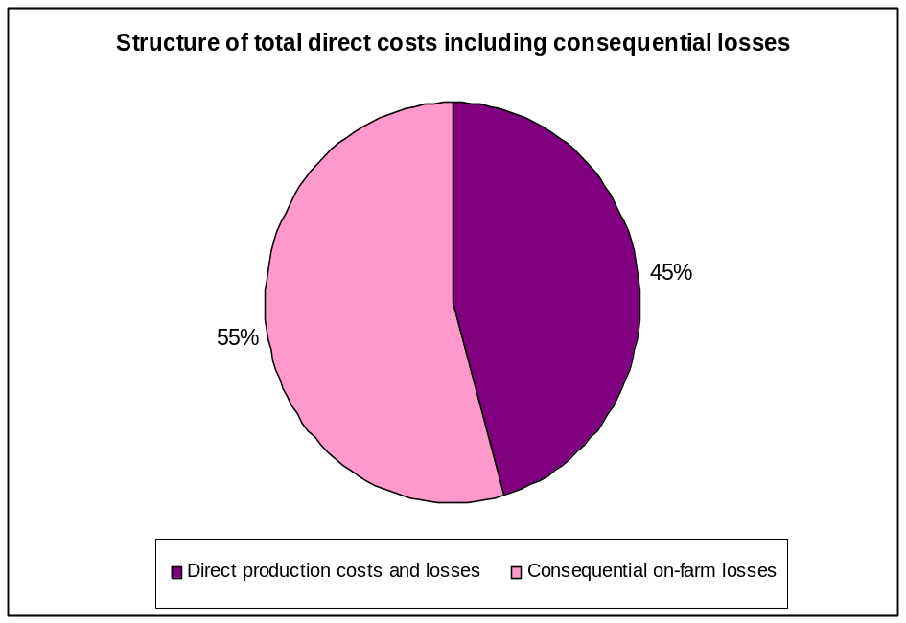
Economic analysis of global outbreak costs (HPAI) /10

Slide 28
Economic analysis of global outbreak costs (HPAI) /11
Results - direct impact (cont’d):
The results for scenarios A and B tend to be very similar, reflecting the relatively small number of countries added in scenario B, given the current state of HPAI outbreaks worldwide;
If this position changes, with a more substantial geographical spread of the disease, then the impact would start moving closer to the substantially higher figures of scenario C;
It is noted that in all cases, the impact is not proportionate to the number of countries added under each subsequent scenario, because the countries in scenarios A and B account for 55% and 63% respectively of the poultry stock of all developing OIE country members;

Slide 29
Economic analysis of global outbreak costs (HPAI) /12
Results - direct impact (cont’d):
Total direct costs and losses (excluding consequential on-farm losses) in scenarios A and B are estimated at US$ 5.3 billion and US$ 6.1 billion respectively (on an annual basis), but would rise up to US$ 9.7 billion if the disease were to spread throughout the developing world;
Including consequential on-farm losses, the total direct impact would be US$ 11.7 billion and US$ 13.5 billion respectively in the case of scenarios A and B, but could rise up to US$ 21.3 billion if the disease were to spread more worldwide along the lines suggested by scenario C.

Slide 30
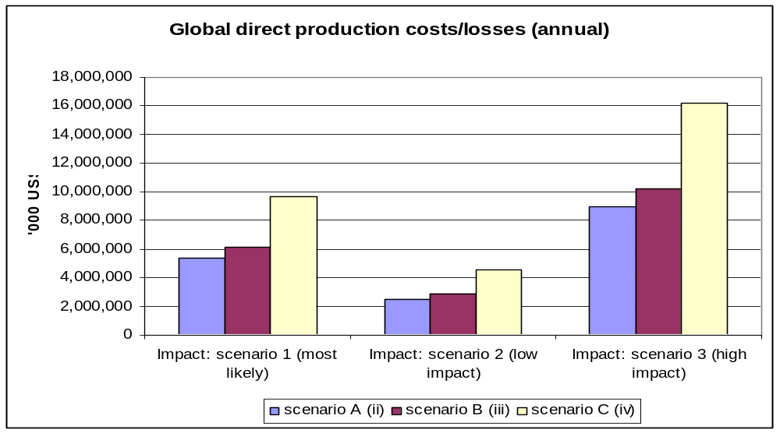
Economic analysis of global outbreak costs (HPAI) /13
Overview of estimated direct impacts under the different scenarios
Note: Includes animal value losses, culling/disposal and control costs

Slide 31
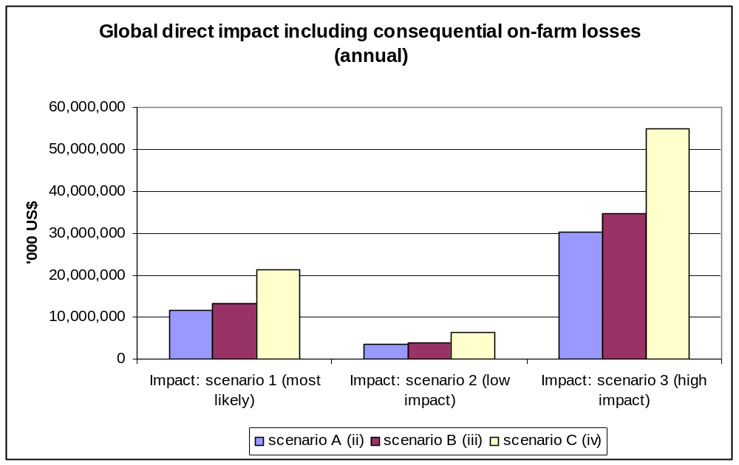
Economic analysis of global outbreak costs (HPAI) /14
Overview of estimated direct impacts under the different scenarios

Slide 32
Economic analysis of global outbreak costs (HPAI) /15
Results - indirect impact:
The various indirect costs have been estimated as a range between 3 possible outcomes from the 3 main scenarios (‘most likely’, ‘low impact’ and ‘high impact’);
Unlike direct costs, it has not been possible to estimate costs per country, due to the complexity of interactions, whereby a loss in one sector may be a gain in another;
Thus, the effects given here are an estimated net impact based on the experience we have now gained from the global impact on world markets following the AI outbreaks of the last few years;

Slide 33
Economic analysis of global outbreak costs (HPAI) /16
Estimated global impact: indirect costs, HPAI (in billion US$)
 | Impact: scenario 1 (most likely)
 | Ripple: domestic market | Ripple: export markets | Spill-over: tourism | Wider society | Total impact
Indirect costs/losses: Global impact, annual | 5.28 | 3.77 | 72.00 | 311.15 | 392.20
 |  |  |  | 711.20 | 792.25
Indirect costs/losses: Global impact, total | 10.56 | 7.55 | 144.00 | 622.30 | 784.41
 |  |  |  | 1,422.40 | 1,584.51

Slide 34
Economic analysis of global outbreak costs (HPAI) /17
Results - indirect impact:
Ripple costs, under the ‘most likely’ scenario, are estimated at US$ 5.3 billion in terms of domestic market losses in the poultry sector and a further US$ 3.8 billion in terms of export market losses on an annual basis;
Assuming a 2 year duration of impact, as is currently the case based on real market baseline trends, the total ripple impact in terms of domestic and export market losses in the poultry sector would be double the above amounts (i.e. US$ 10.6 billion and US$ 7.5 billion respectively);

Slide 35
Economic analysis of global outbreak costs (HPAI) /18
Results - indirect impact (cont’d):
Spill-over effects in the tourism sector alone are estimated to amount to US$ 72 billion on an annual basis under the ‘most likely’ scenario and double that amount assuming a 2-year duration of the impact (i.e. US$ 144 billion);
Wider society costs, in the event of a human pandemic, are several multiples of all costs, and depending on the severity of the outbreak these are estimated at US$ 311.2 billion (at 15% attack rate), and at US$ 711.2 billion (at a 35% attack rate) on an annual basis alone;

Slide 36
Economic analysis of global outbreak costs (HPAI) /19
Results - indirect impact (cont’d):
These costs exclude certain types of indirect impacts for which it has not been possible to provide estimates on a global scale (e.g. ripple effects on upstream/downstream industries, spill-over effects on services and other wider society costs such as environmental effects);
In this context, the estimates of total indirect impact provided here should be considered as the minimum potential outcome.

Slide 37
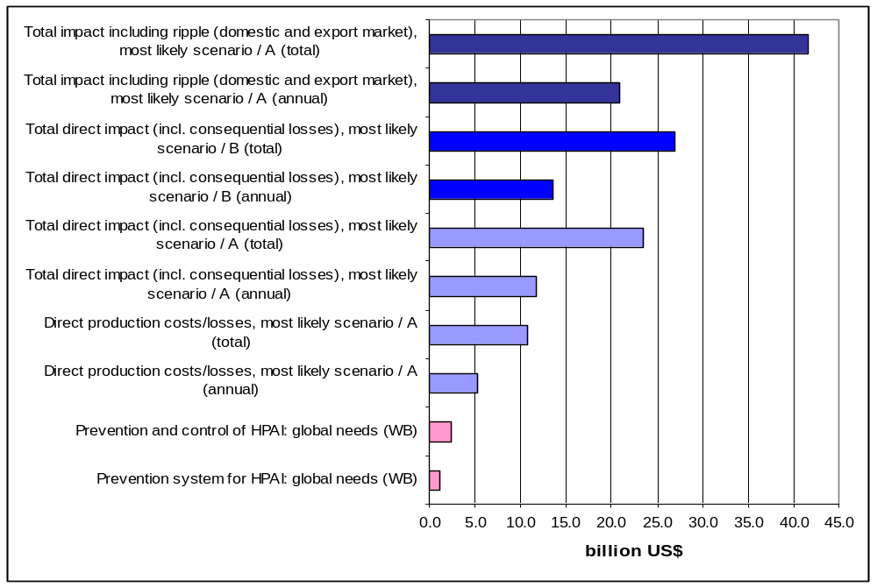
Global comparison of prevention to outbreak costs (HPAI) /1

Slide 38
Global comparison of prevention to outbreak costs (HPAI) /2
Conclusions:
The most recent global needs assessments of prevention and response to HPAI suggest that some US$ 2.27 billion would be required over a 3-year period;
Of this amount, prevention and preparedness costs as such account for just over US$ 1 billion (excluding operational costs);
Against this assessment, outbreak costs under the ‘most likely’ scenario and for H5N1 countries only are estimated at US$ 5.34 billion per year for the direct production costs and losses alone (excluding consequential losses);

Slide 39
Global comparison of prevention to outbreak costs (HPAI) /3
Conclusions (cont’d):
Adding consequential on-farm losses, the total direct impact comes to US$ 11.75 billion per year;
Assuming the impact of an outbreak spread over a period of 2 years (‘most likely scenario’) the total direct impacts would be US$ 10.7 billion excluding consequential on-farm losses and US$ 23.5 billion if these losses are included;
Moving towards scenarios B and C these costs increase further to US$ 12.3 billion and US$ 26.9 billion respectively (in the case of scenario B) and to US$ 19.4 billion and US$ 42.7 billion respectively (in the case of scenario C);

Slide 40
Global comparison of prevention to outbreak costs (HPAI) /4
Conclusions (cont’d):
Before even considering the indirect impacts, the benefits of improved prevention by far outweigh the potential outbreak costs and losses;
Adding potential ripple effects (in terms of the potential losses in domestic and export markets) to the above scenarios would bring the total impact to US$ 41.6 billion over a 2 year period;
The estimated direct impact (excluding consequential losses) per year for the LDCs as a group ranges from US$ 72.6 million in scenario A (4 LDCs affected) to US$ 258 million in scenario B (8 LDCs) and US$ 585 million in scenario C (40 LDCs).

Slide 41
Conclusions & recommendations /1
Despite progress, the current state of VS and preparedness levels in developing/transition countries continues to pose a real and present threat to the prevention and controls of TADs;
It is difficult to predict the severity of potential threats posed by TADs, while different issues arise depending on the nature of the disease, resulting in various types of socio-economic impacts;

Slide 42
Conclusions & recommendations /2
Evidence from the literature analysis as well as the results of our extrapolations in the specific case of HPAI, overwhelmingly suggests that TADs have the potential to lead to substantial and widespread consequences, especially in today’s globalised markets;
In particular, their impacts have implications in terms of public health, food security, poverty alleviation, and social equity/stability;
This calls for a global approach in the fight against animal diseases, and it is clear that the VS have a crucial role to play in “peace time” as well as during “crisis time“ as the providers of Global Public Goods.

